Slide 1
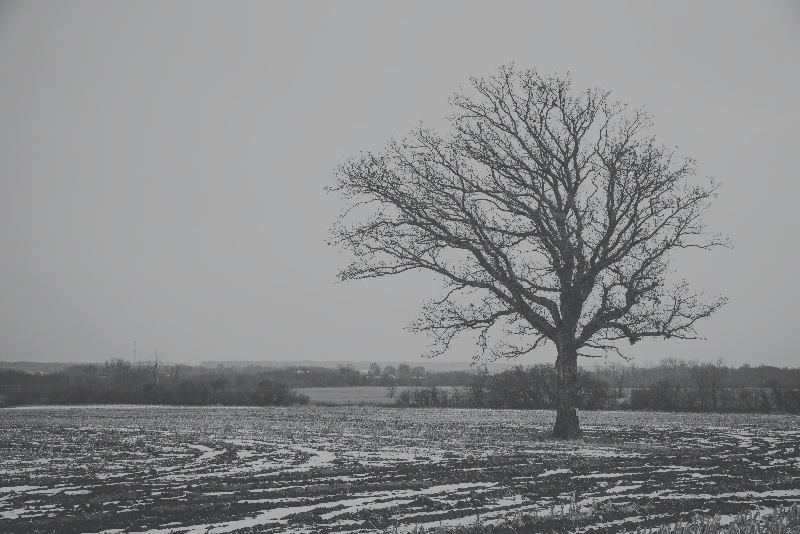
Introduce My Self
LEE CHANG YEOB / YeoPEVA
2023.12.08 / LEE CHANG YEOB

Slide 2
Table of Contents
Before Start..

Slide 3
Table of Contents
Personal Data
Experience
matters
Portfolio
For the Future
Before END.

Slide 4
Personal Data
Lee Chang Yeob?

Slide 5

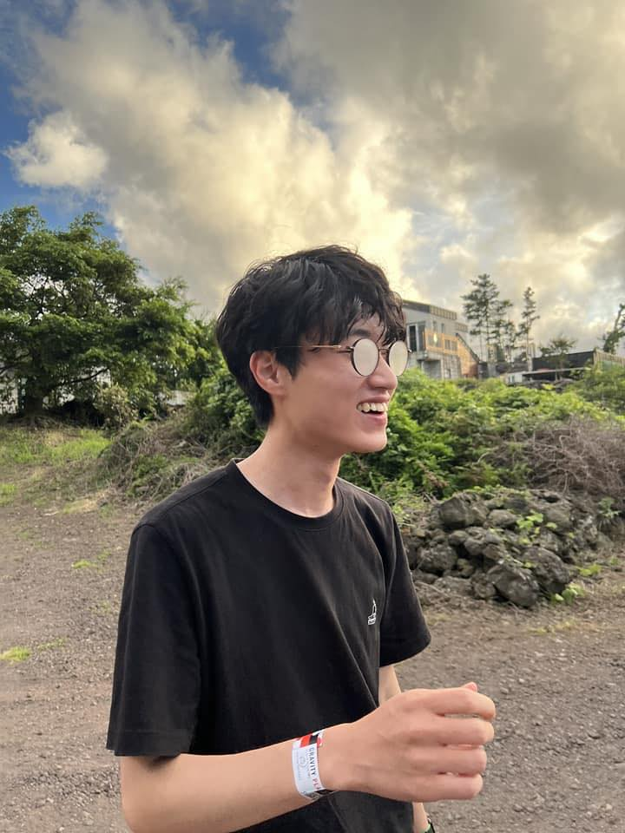
Personal Data
Who is Lee CHANG YEOB?
DCU / Daegu Catholic University
Department of Computer Software
Name : LEE CHANG YEOB
Phone : 010-8652-9464
Email : lcy496530@gmail.com
Profile : https://info.yeopeva.me/

Slide 6


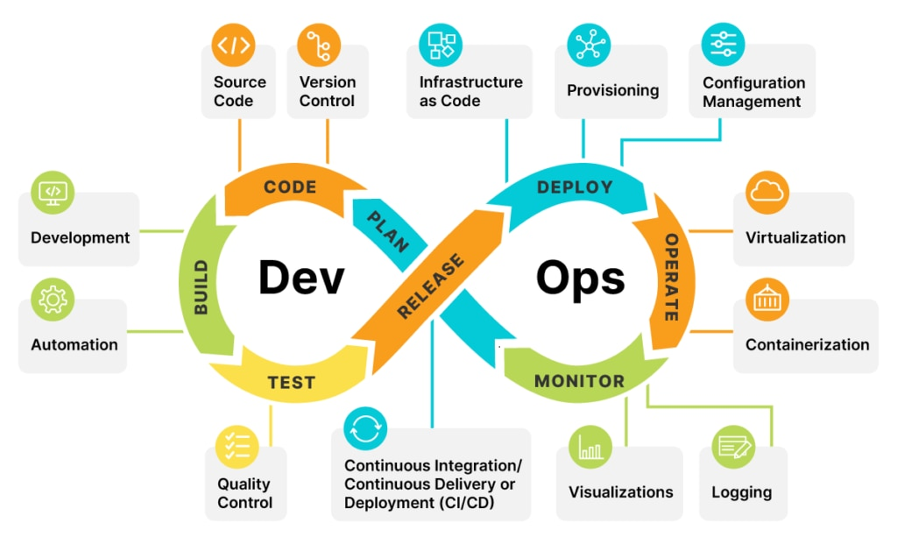

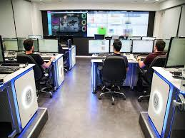
Personal Data
Who is Lee CHANG YEOB?
A field of interest?
DevOps
Backend (Web)
Cloud
AWS, Azure
GCP, Naver Cloud
DFIR (Incident Response)
+) CERT

Slide 7
Experience
What kind of
experience did you have?

Slide 8
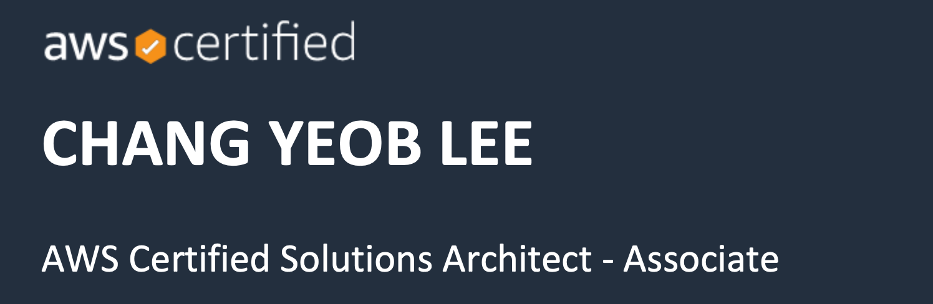
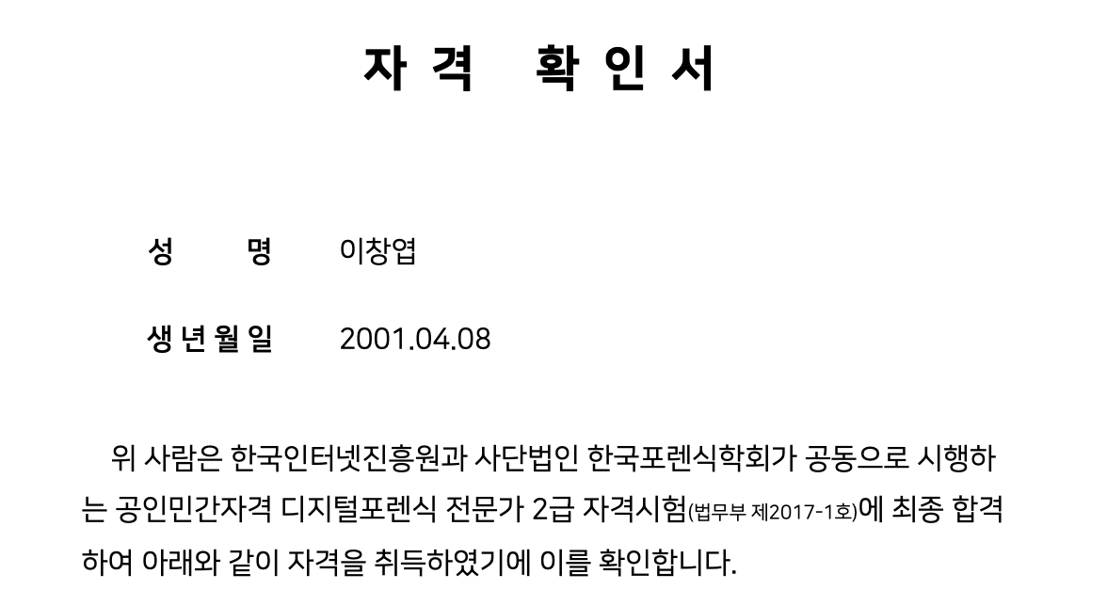
Experience matters
Certificate
Certificate (Local / RoK)
Network Administrator Level 2
Linux Master Level 2
Internet Information Manager Level 2
Information device operation technician
Digital forensics level 2
Certificate (Foreign)
Exterro ACE (FTK)
AWS Solution Architect - Associate

Slide 9

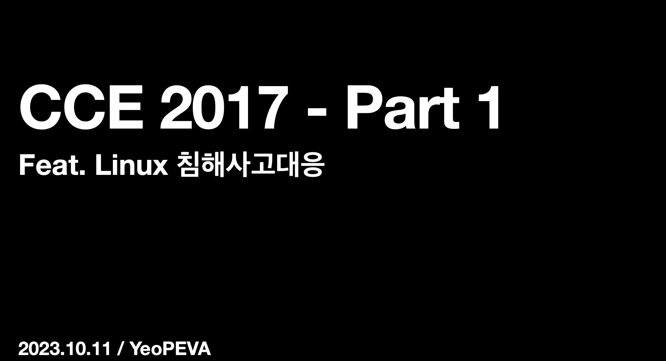

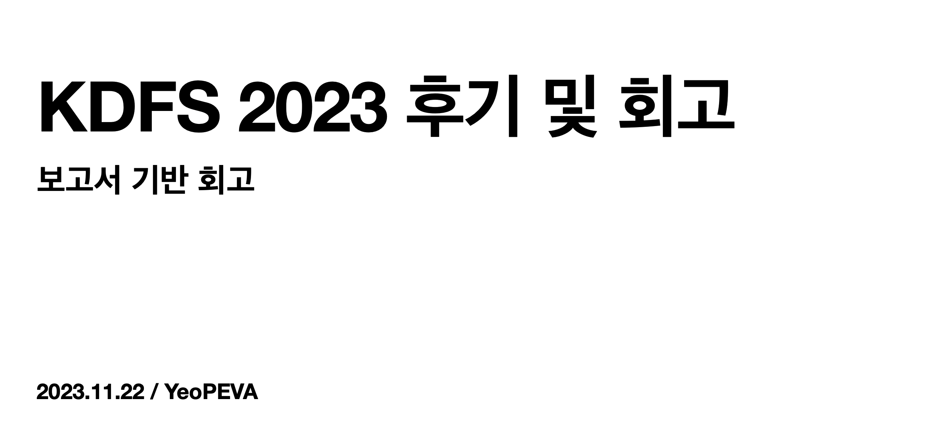
Experience matters
School Activities
School Activities
i-Keeper
It is active within Information Protection (CERT).
Conduct research related to digital forensics.

Slide 10

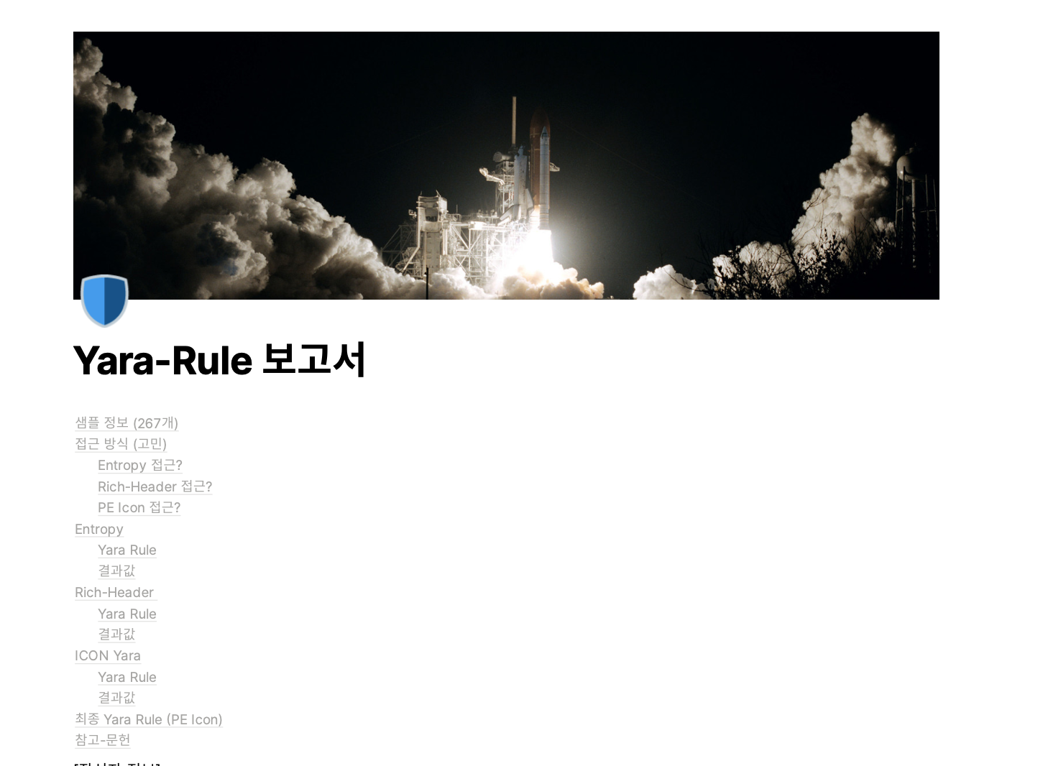

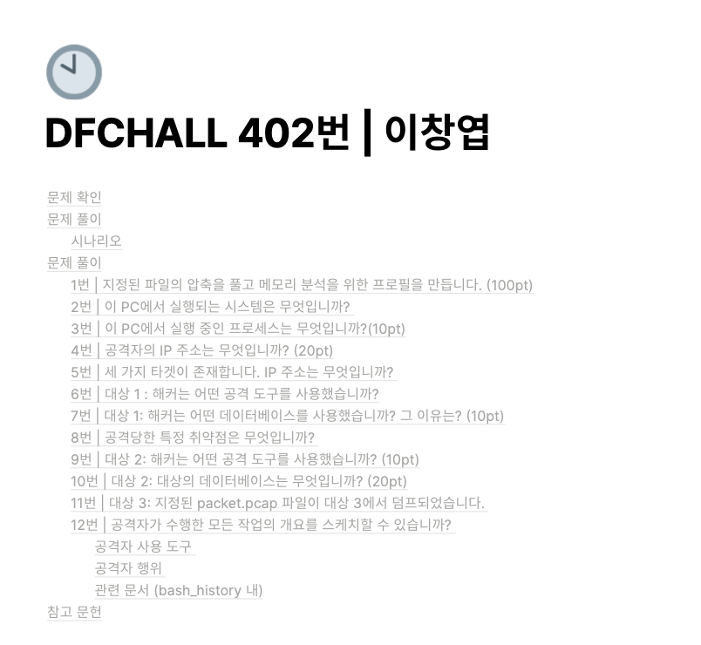

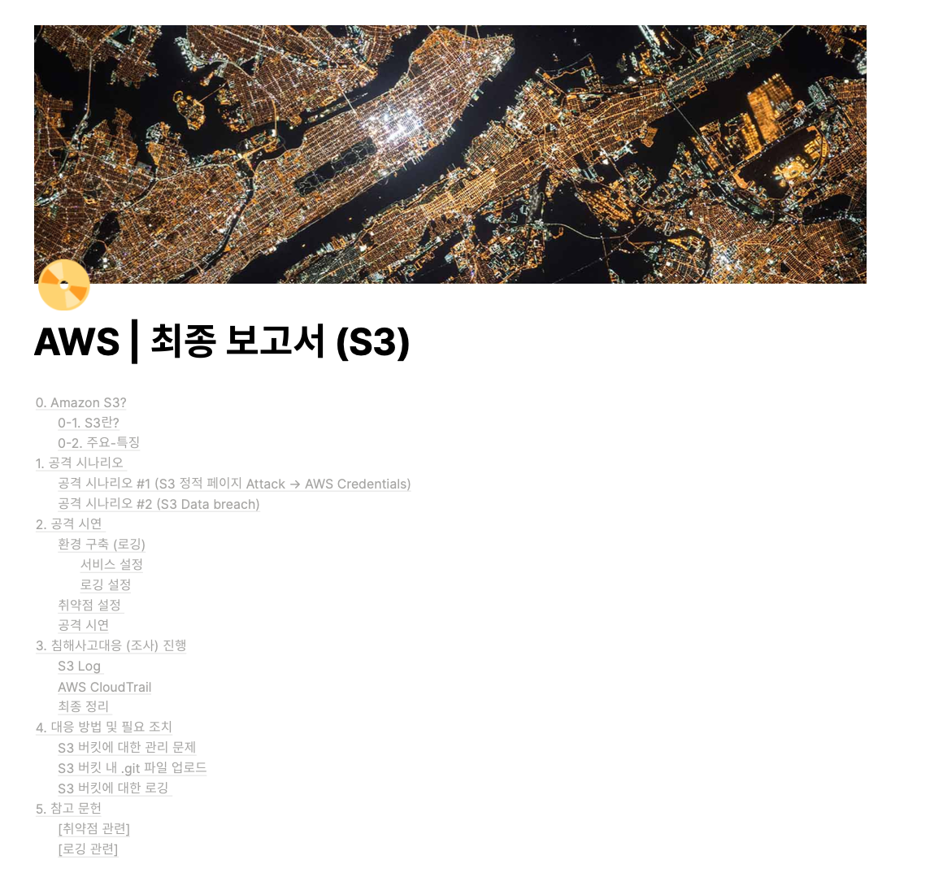
Experience matters
Best of the Best / BoB 9th DFIR
BoB 9th DFIR
Completed the 9th Digital Forensics Track
the Next Generation
Security Leader Training Program.
Through this program,
various activities and learning related to
Digital Forensics and Incident Response.

Slide 11
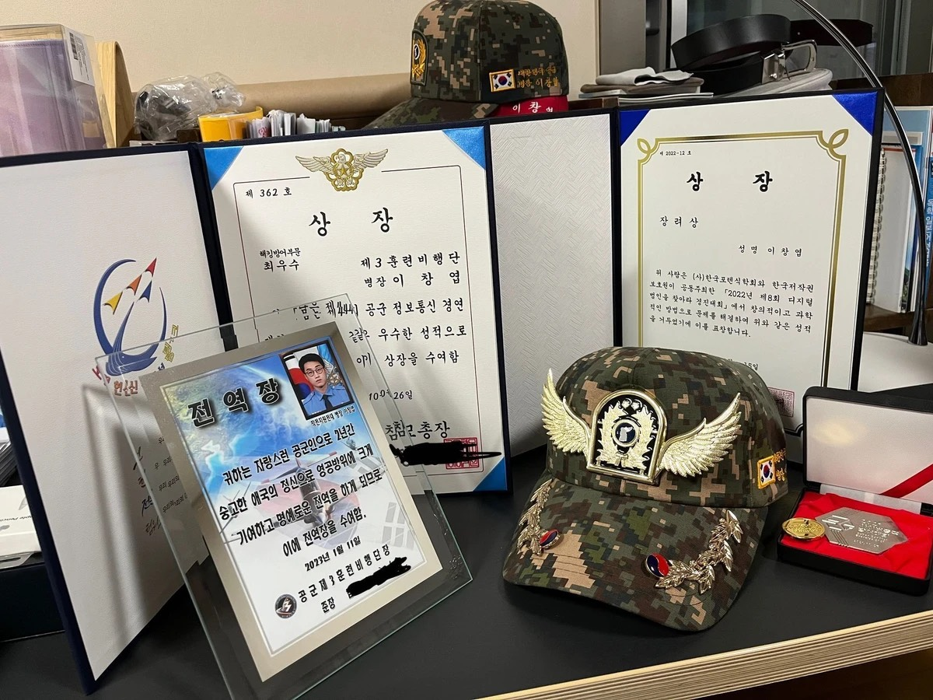
Experience matters
ROKAF / Cyber Security Soldier
ROKAF / Cyber Security
Within the Korean Air Force
responsible for managing
controlling information protection equipment
managing policies and blockages
and responding to training
related to information protection.

Slide 12
Portfolio
What projects
have you done?

Slide 13

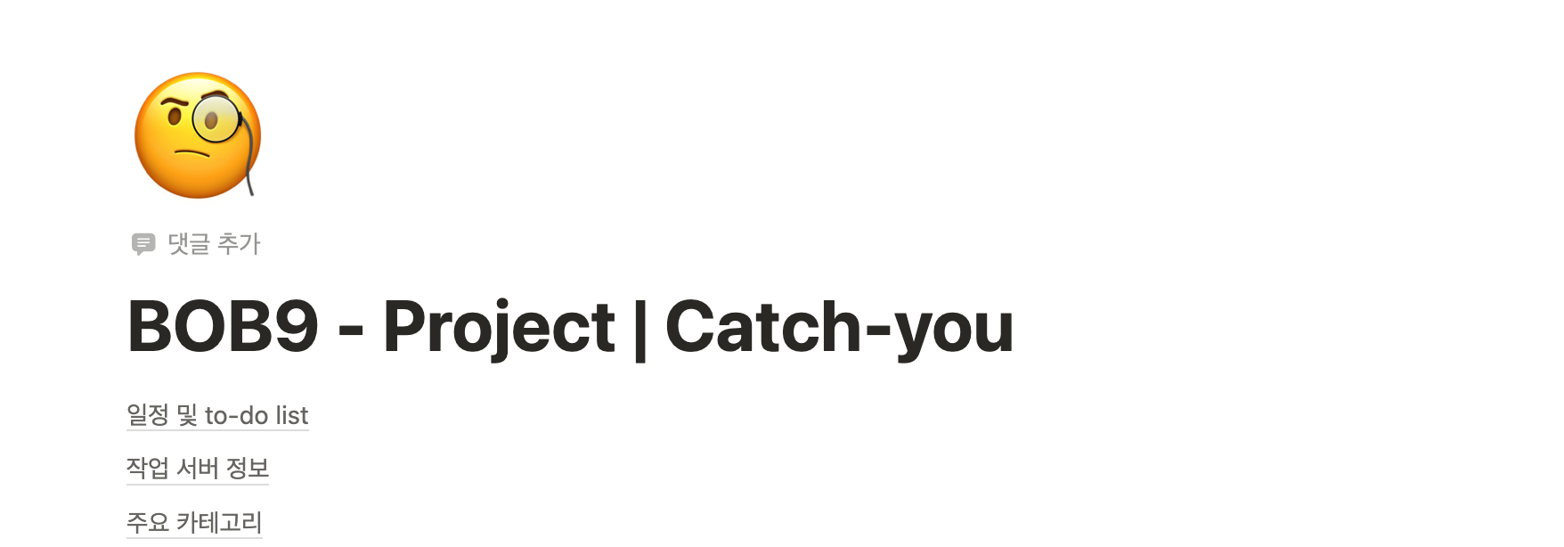

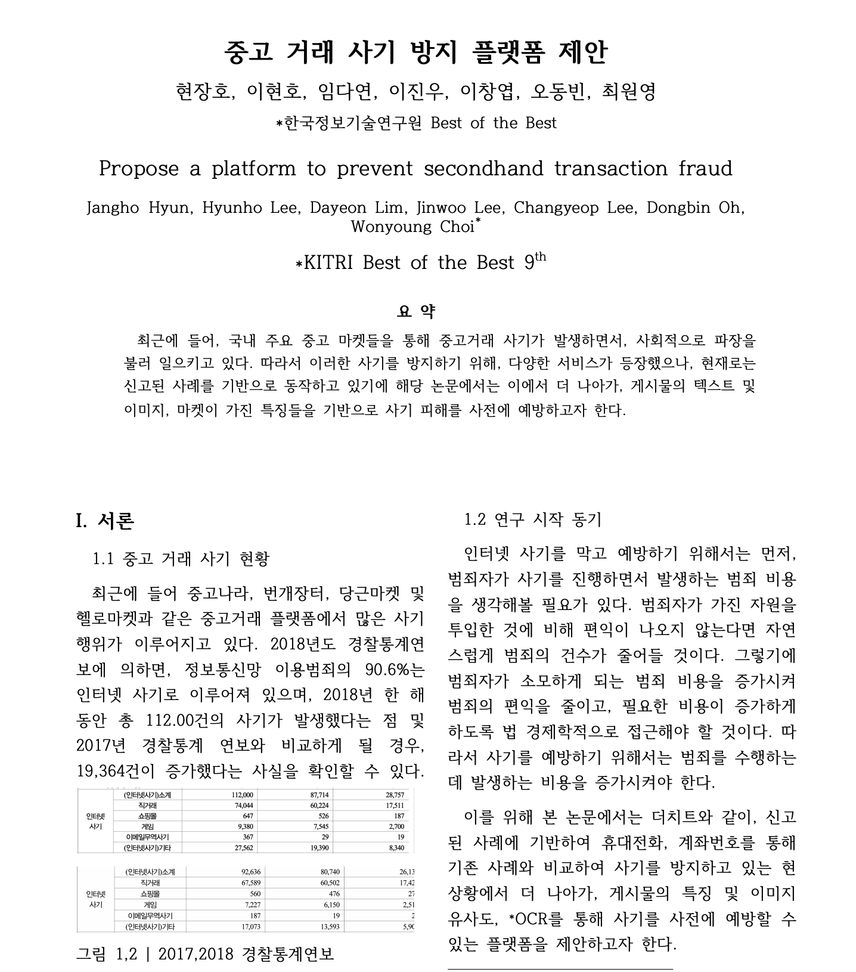

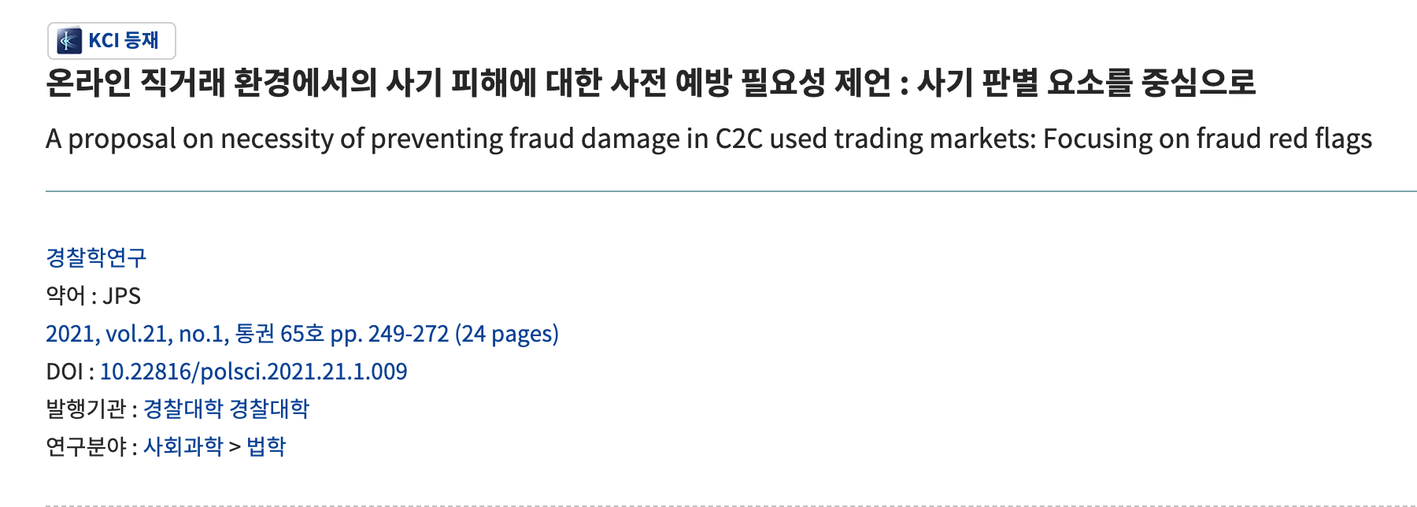
Portfolio
Prevention of secondhand transaction fraud
Prevention of secondhand transaction fraud
Regarding the prevention of secondhand transaction fraud,
I participated as the
backend and researcher of the project
that can detect the fraud and pattern of the
secondhand transaction item by entering the URL
of the secondhand transaction item into the platform.

Slide 14

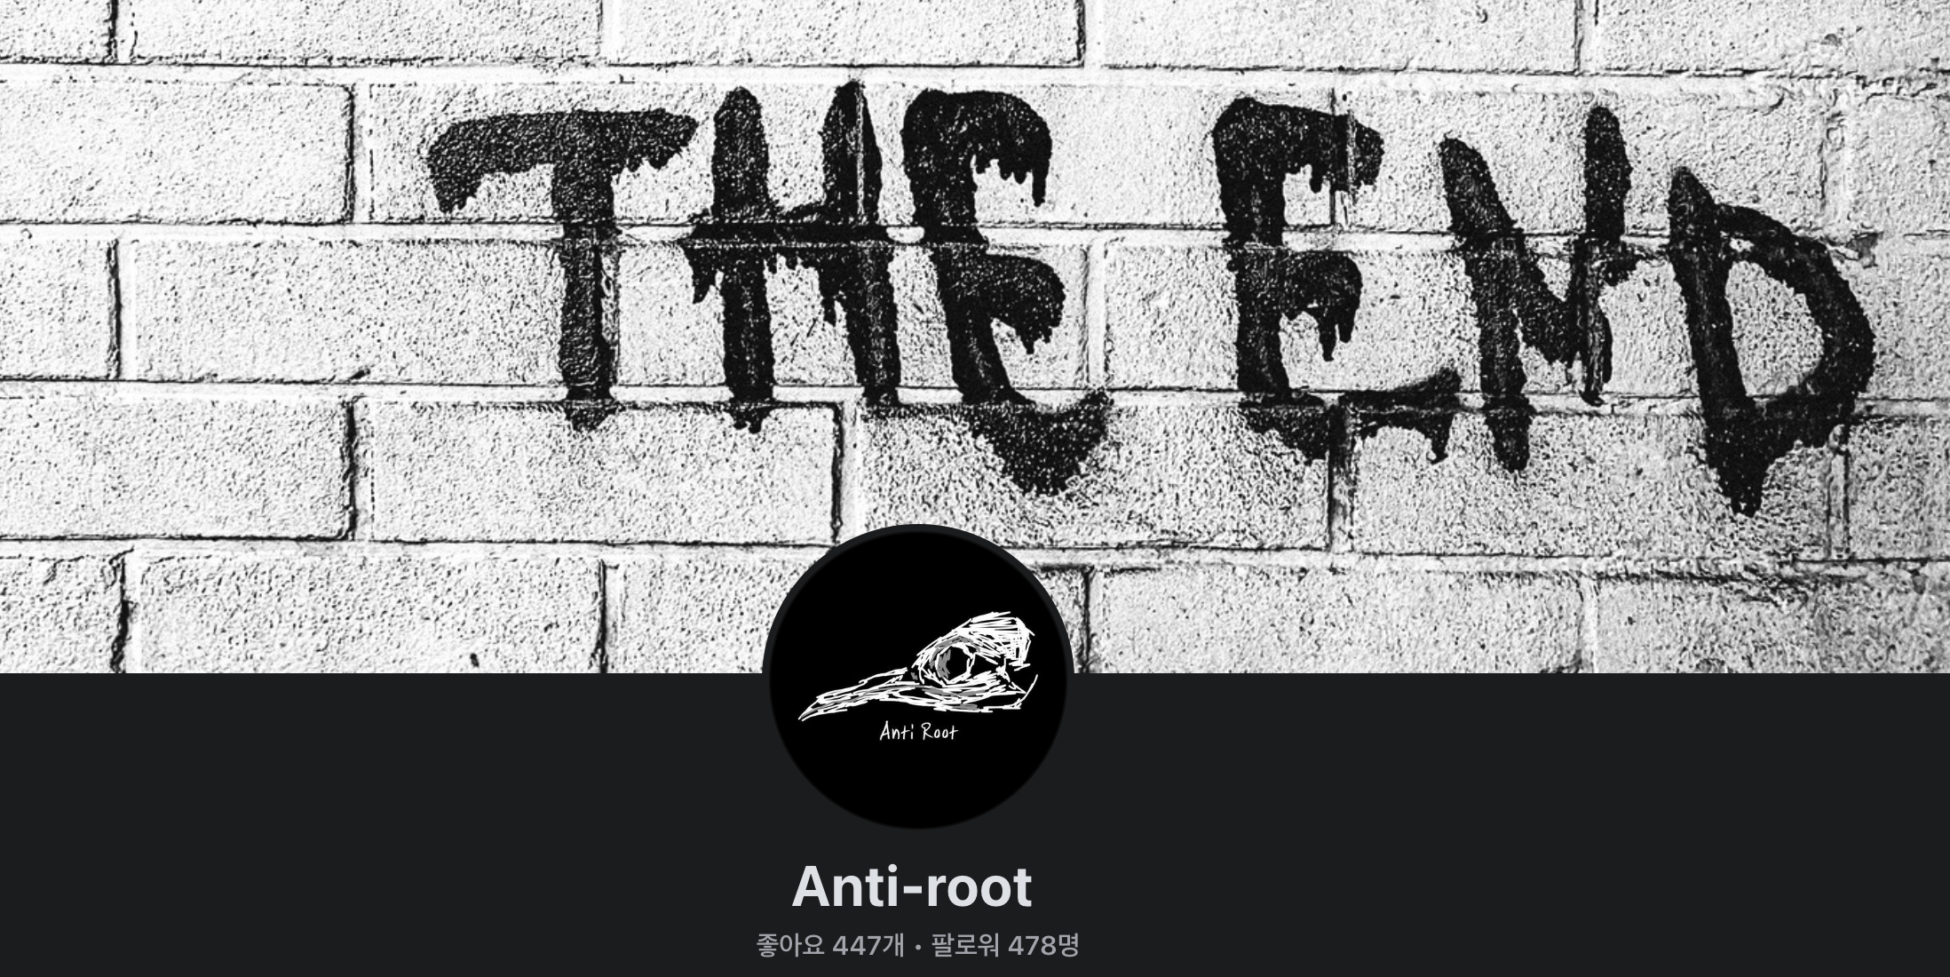

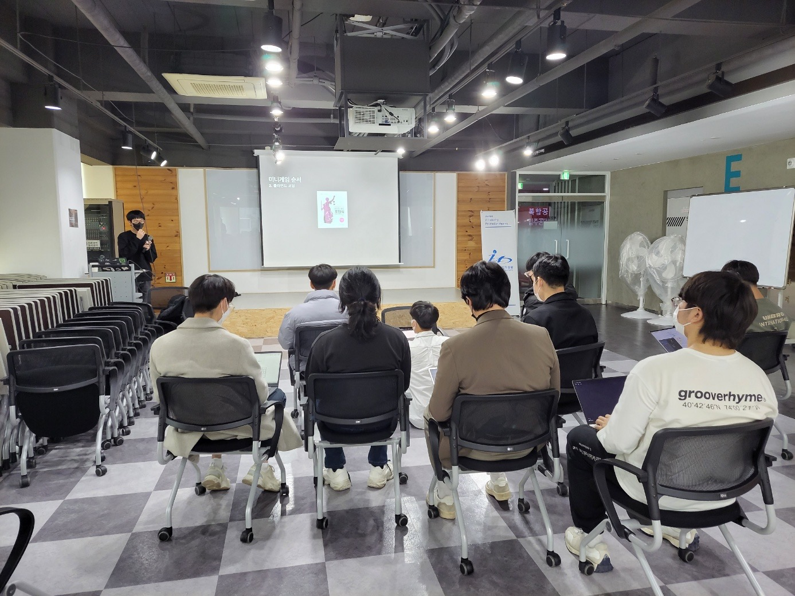
Portfolio
Anti-root / Team Operation
Anti-root
Establish Anti-root team
Team leader
in 2017 ~ 2023.02
Various information protection studies
regular online and offline seminars
were held in the Yeongnam area.

Slide 15
For the Future
Future Plans

Slide 16



For the Future
Development
I would like to work on various projects and learning
related to the backend and cloud.
In addition, I will try to build deeper knowledge
related to DevOps,
various development methodologies, and CS.

Slide 17


For the Future
Cyber Security
I would like to continue to produce various tools and platforms.
Incident Response & DFIR
with Cloud & Cryptocurrency
But now, rather than approaching it as a job,
I'm trying to proceed as a hobby.

Slide 18
Before END.
With DCU

Slide 19

Before END.
From the second grade,
I will major in
computer engineering and cybersecurity.
I would like to create various services
to improve the inconvenience with in
Daegu Catholic University and club.
For now, I'm hoping for a development-related job
(backend developer, DevOps, cloud engineer)
rather than DFIR(CERT)
when I get my final job.

Slide 20
END.

Slide 21
Capstone Design EXPO in DCU
캡스톤 디자인 EXPO 후기

Slide 22

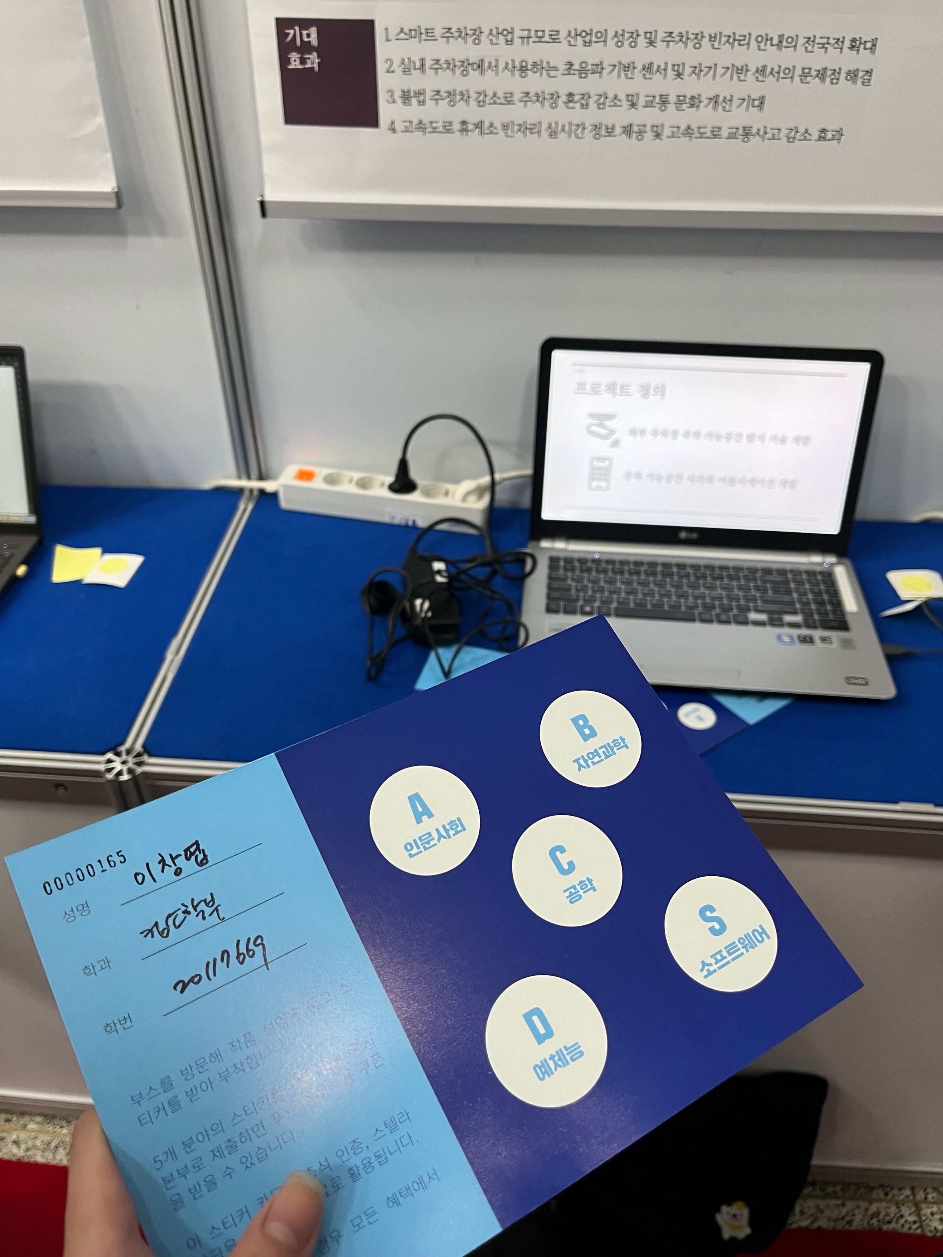
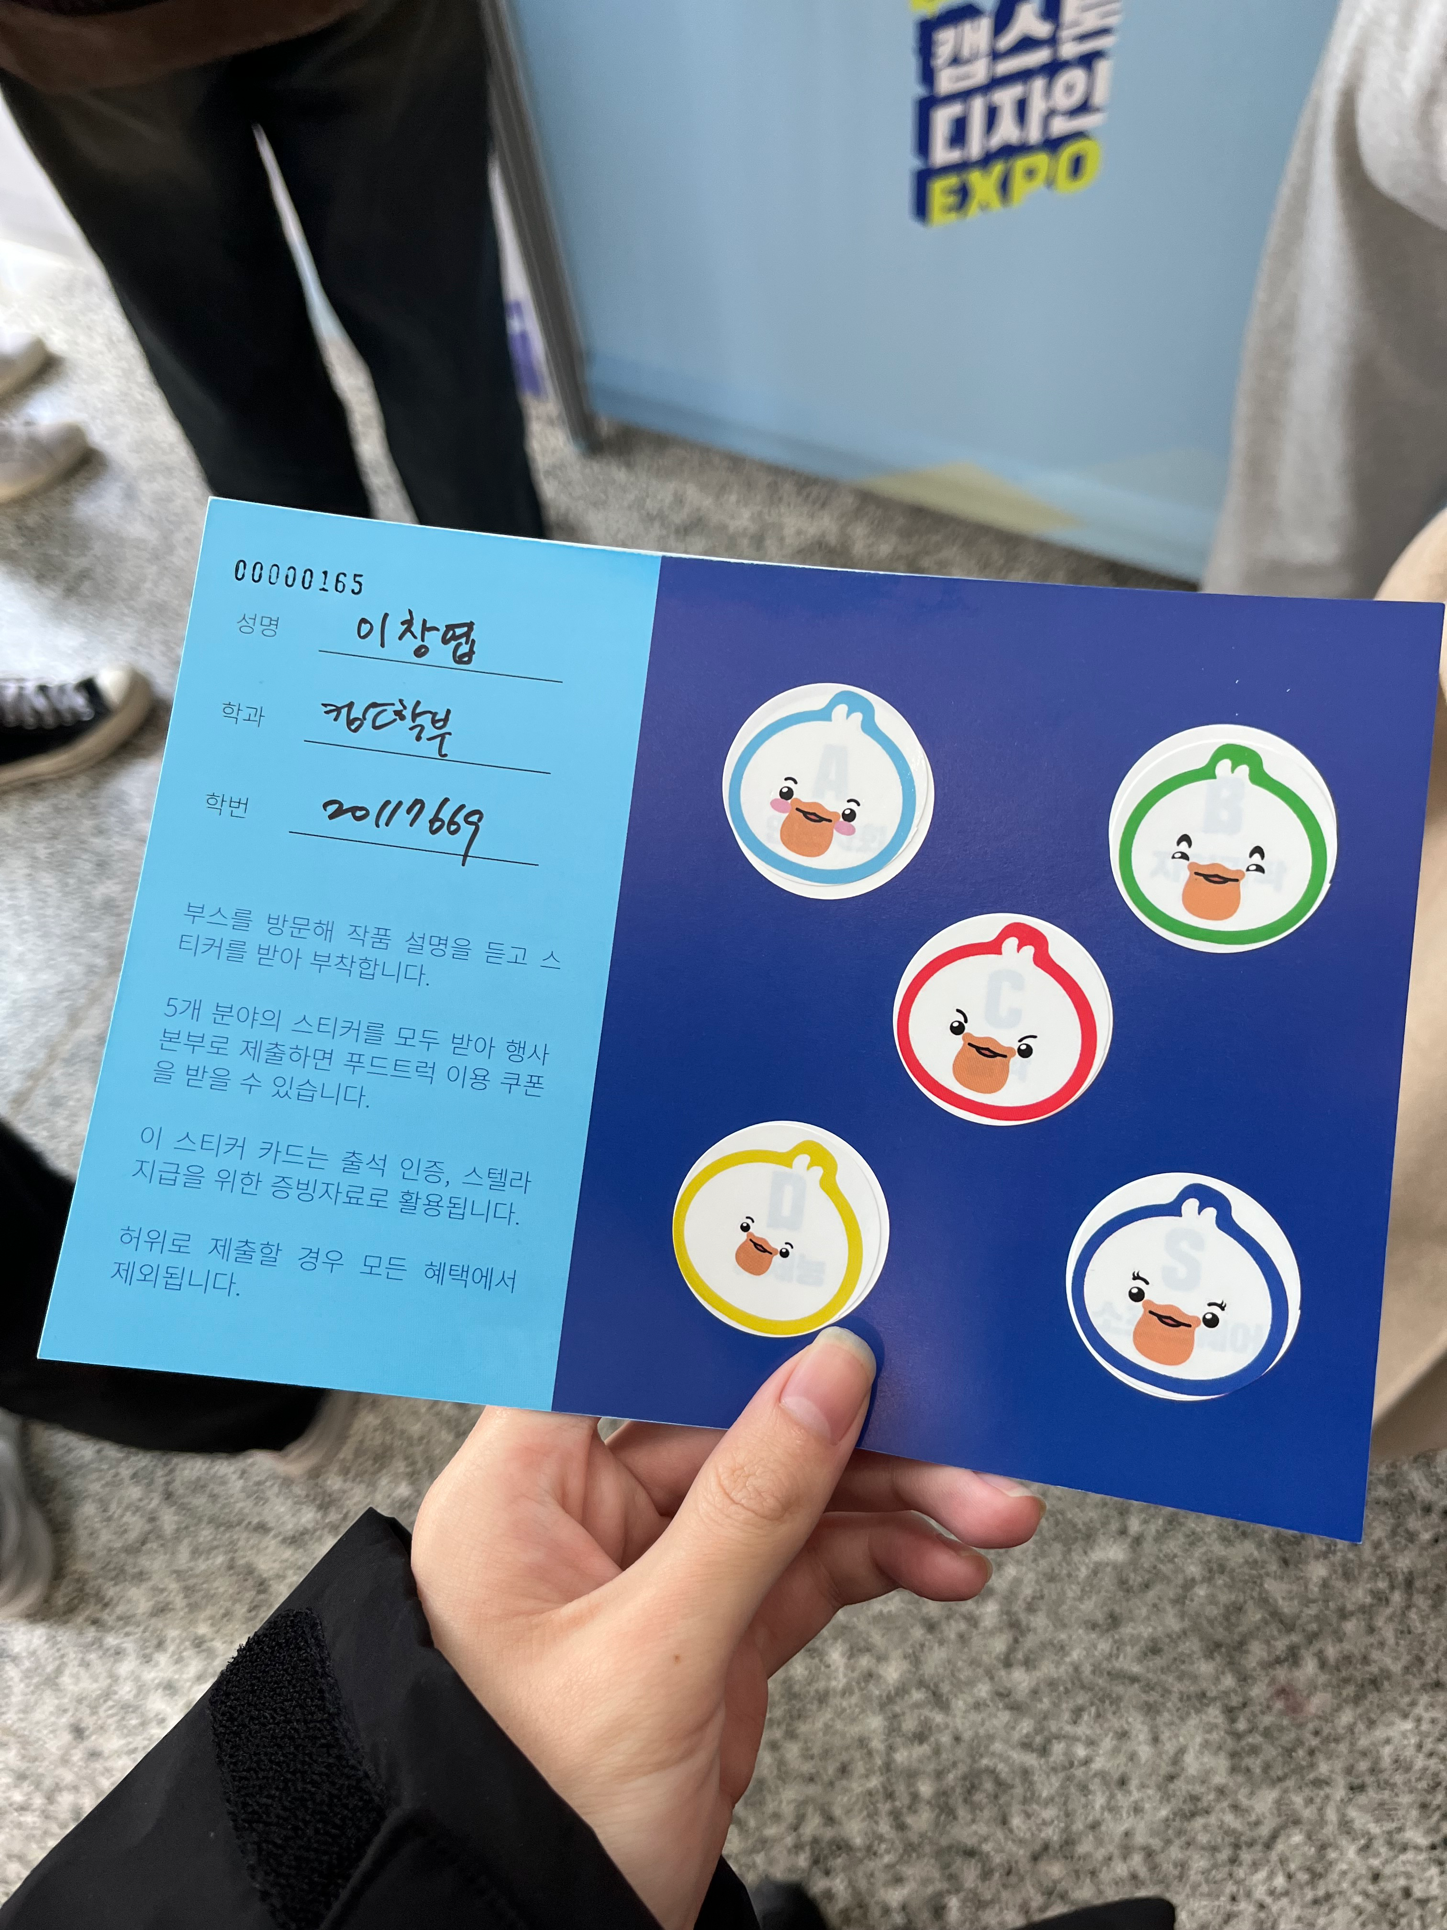
캡스톤 디자인 EXPO 후기
참관 후기
이번 DCU 캡스톤 디자인 EXPO에 참가하였습니다.
총 5개 분야인
인문사회 / 자연과학 / 공학/ 예체능 / 소프트웨어
5개 분야에 대한 캡스톤 프로젝트를 봤습니다.
그 중 소프트웨어 2개 프로젝트와 관련하여
인상이 깊었기에, 해당 프로젝트를
보고 느낀 점에 대해 기입하였습니다.

Slide 23

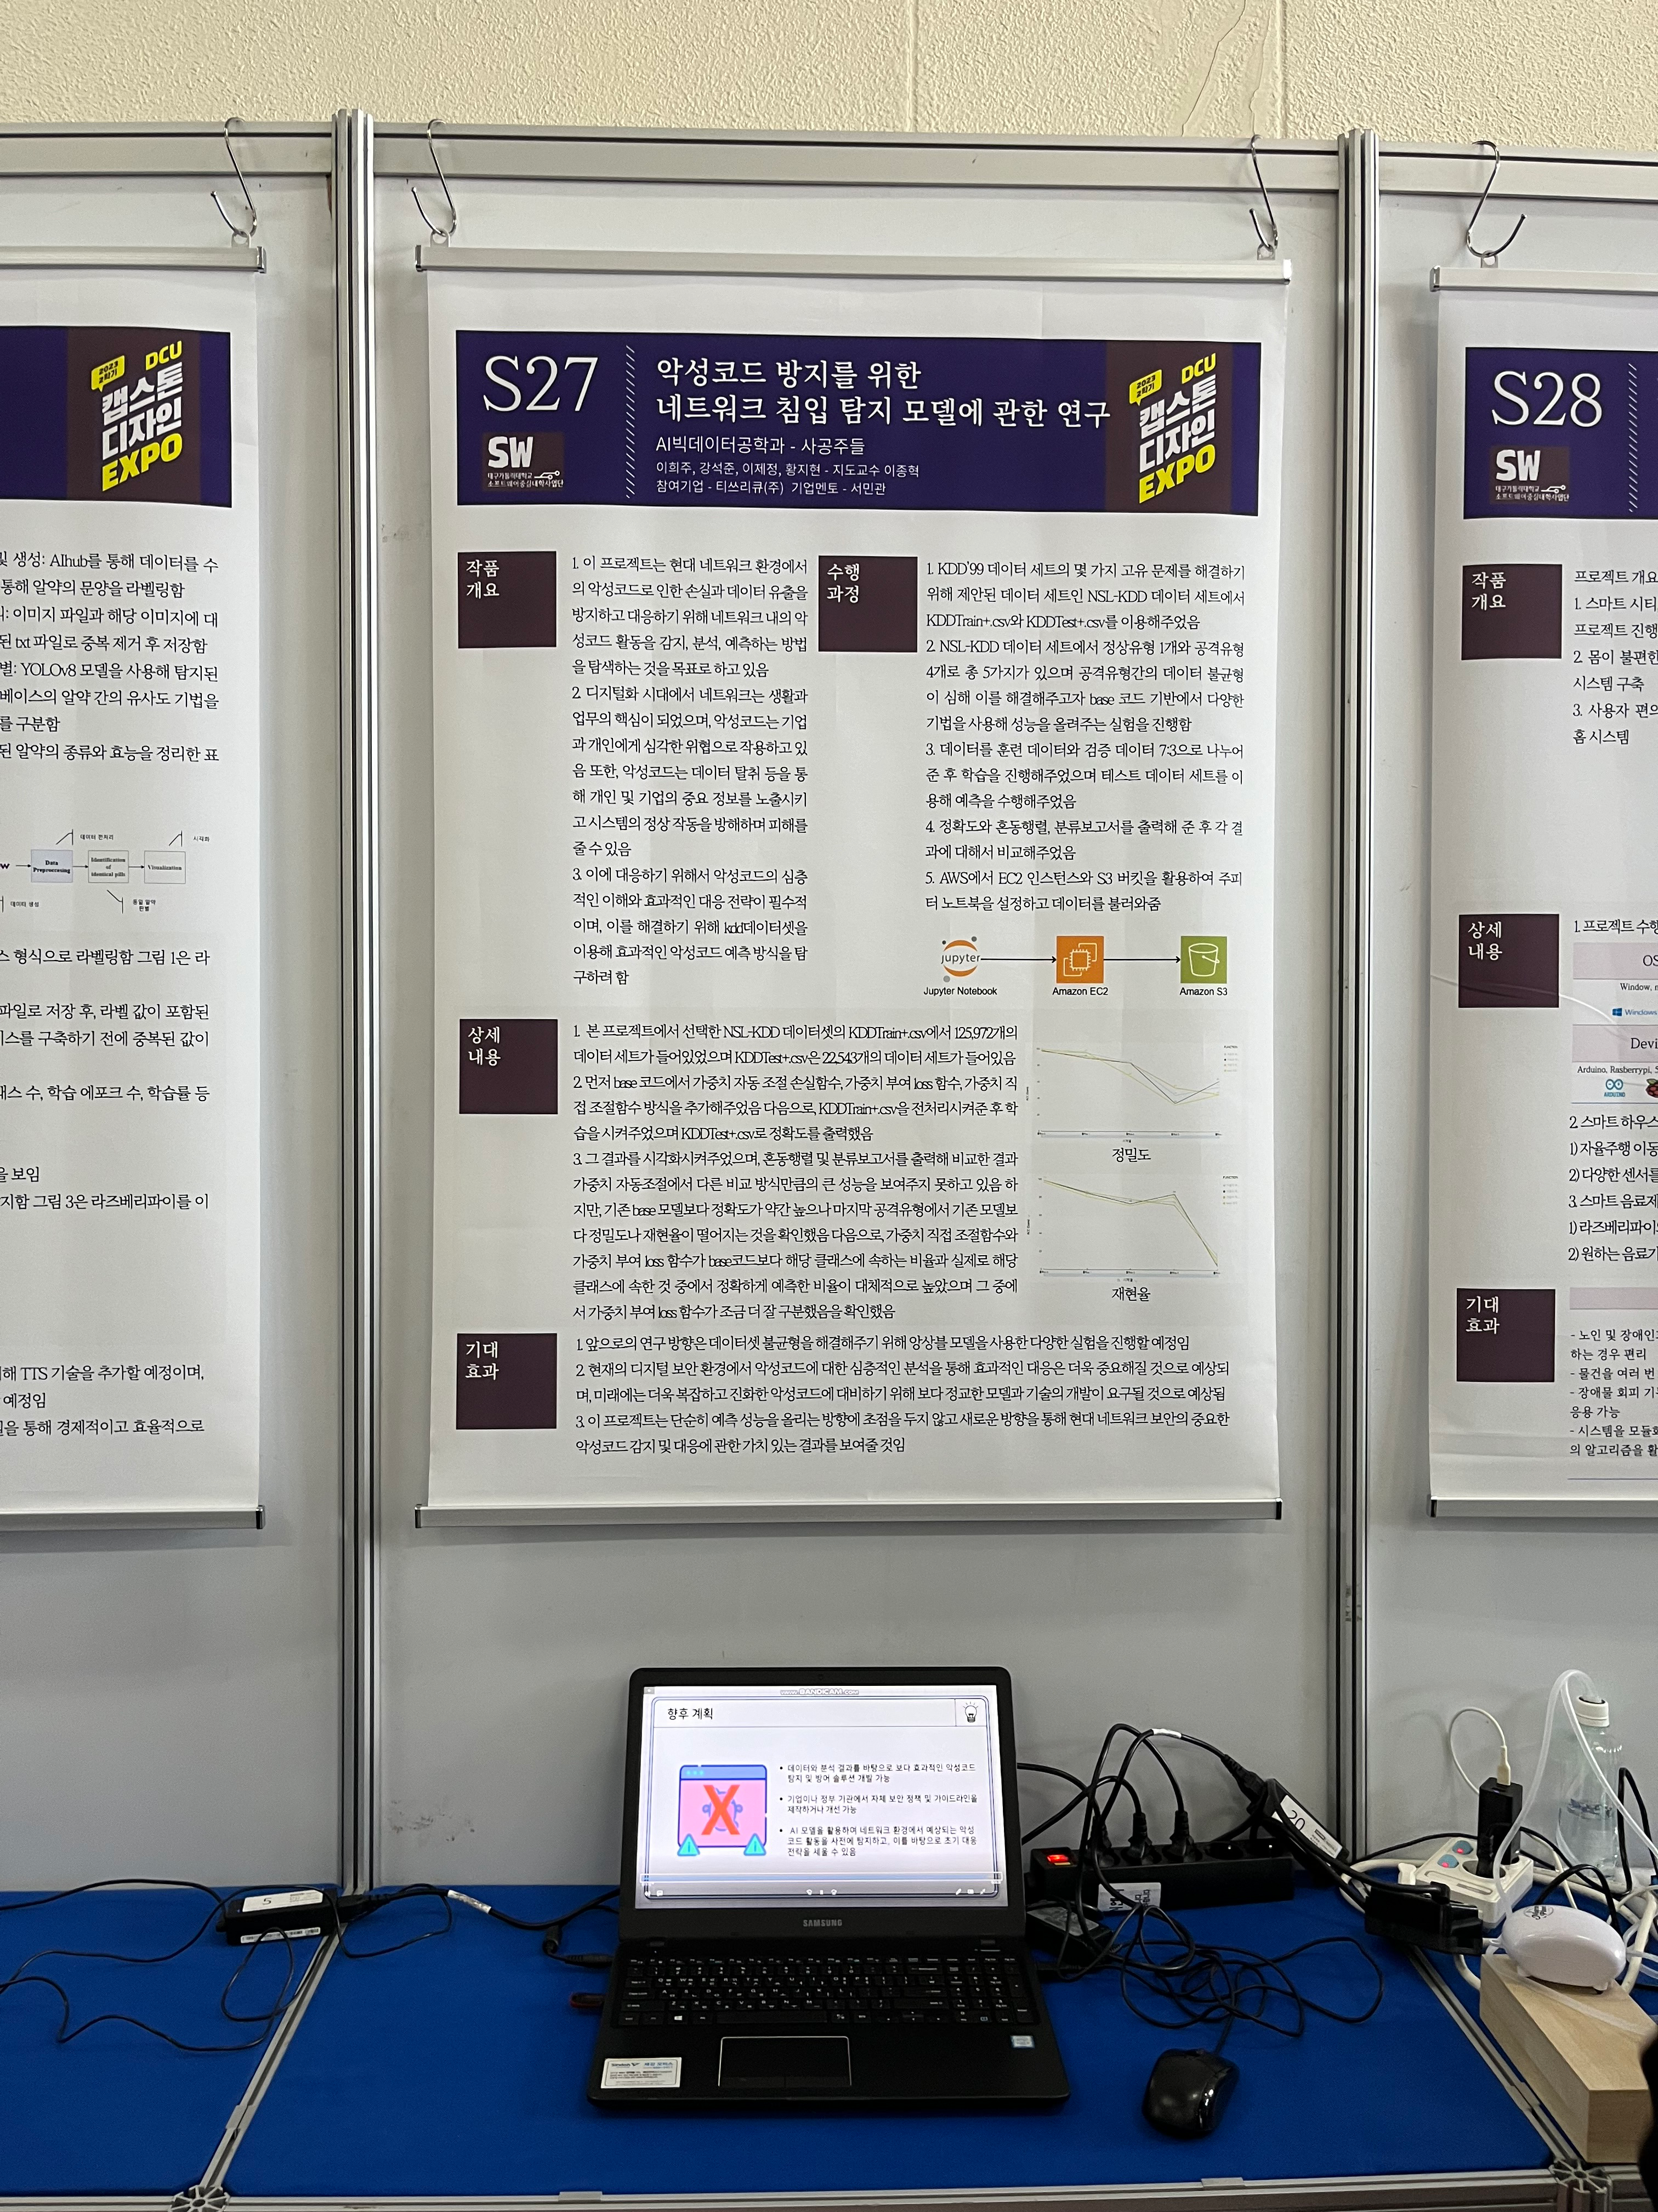
캡스톤 디자인 EXPO 후기
관심 작품 - 1/ 악성코드 방지를 위한 네트워크 침입 탐지 모델에 관한 연구
악성코드 방지를 위한 네트워크 침입 탐지 모델에 관한 연구
악성코드 심층 이해 & 효과적인 대응 전략 연구를 위한
NSL-KDD 데이터셋 분석 및 연구 진행
네트워크 침입 탐지 모델과 관련된 연구를 진행한 것이 신기했습니다.
NSL-KDD 데이터셋과 관련하여
해당 데이터셋을 사용한 이유와
해당 데이터셋에 대한 설명이 좀 더 있었다면 더 좋았을 것 같습니다.

Slide 24

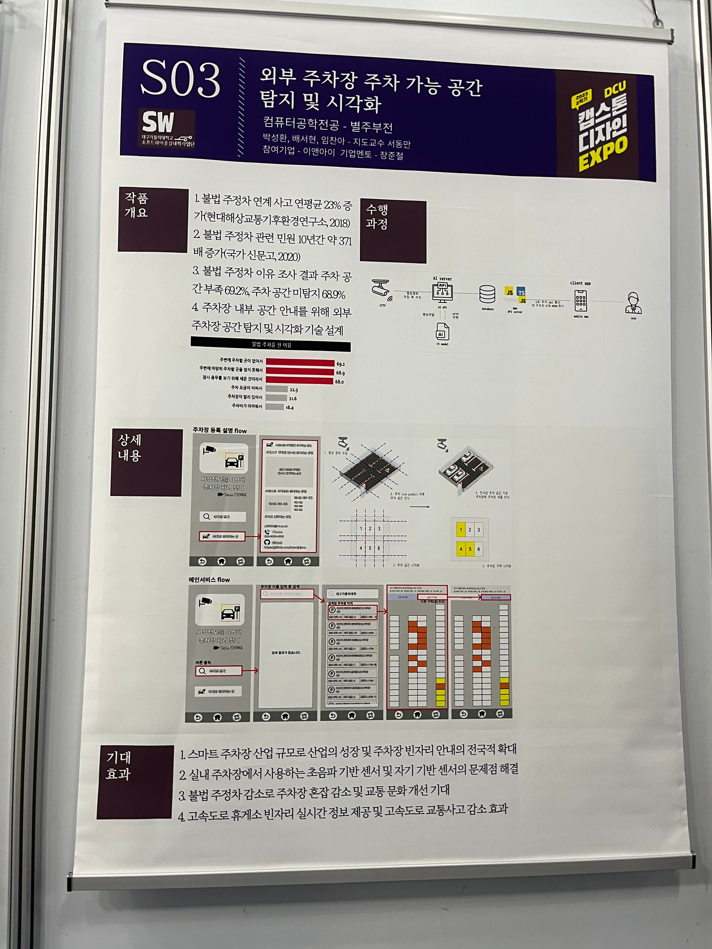
캡스톤 디자인 EXPO 후기
관심 작품 - 2 / 외부 주차장 주차 가능 공간 탐지 및 시각화
외부 주차장 주차 가능 공간 탐지 및 시각화
영상 정보를 AI를 통해 판단
주차장의 자리 여부를 판단하는 프로젝트였습니다.
실제로 주차장 공간과 관련하여 다소 어려움을 겪은 경험이 있는데
그 점에서 상당히 관심 깊게 기억에 남은 프로젝트인 것 같습니다.

